Slide 1


ANEKA CLOUD ARCHITECTURE
An Implementation of the PaaS Model

Slide 2
Contents
What is Aneka?
Features of Aneka
Aneka Resource Provisioning
Hybrid Cloud Implementation
The Amazon EC2 Resource Pool

Slide 3
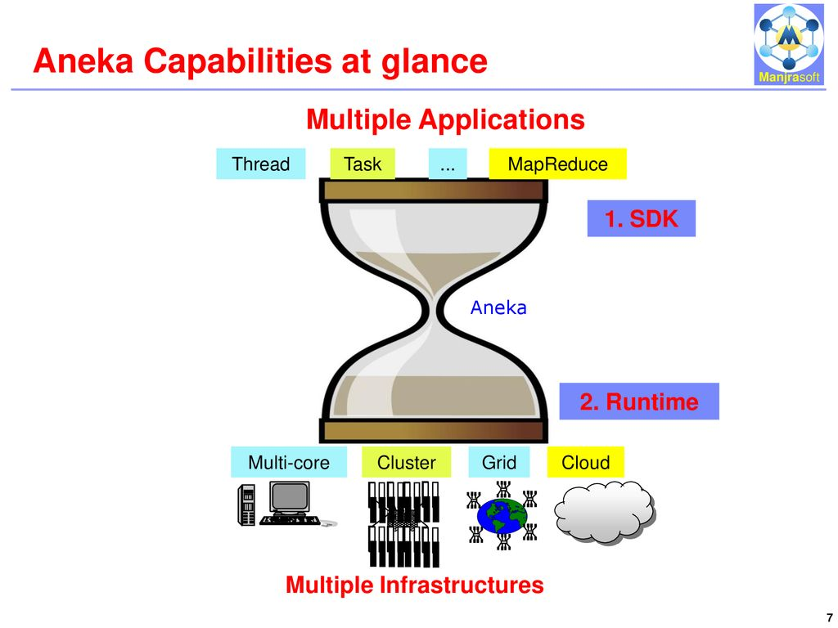
Aneka
Aneka is a software platform and a framework for developing distributed applications on the cloud.
Aneka is essentially an implementation of the PaaS model.

Slide 4
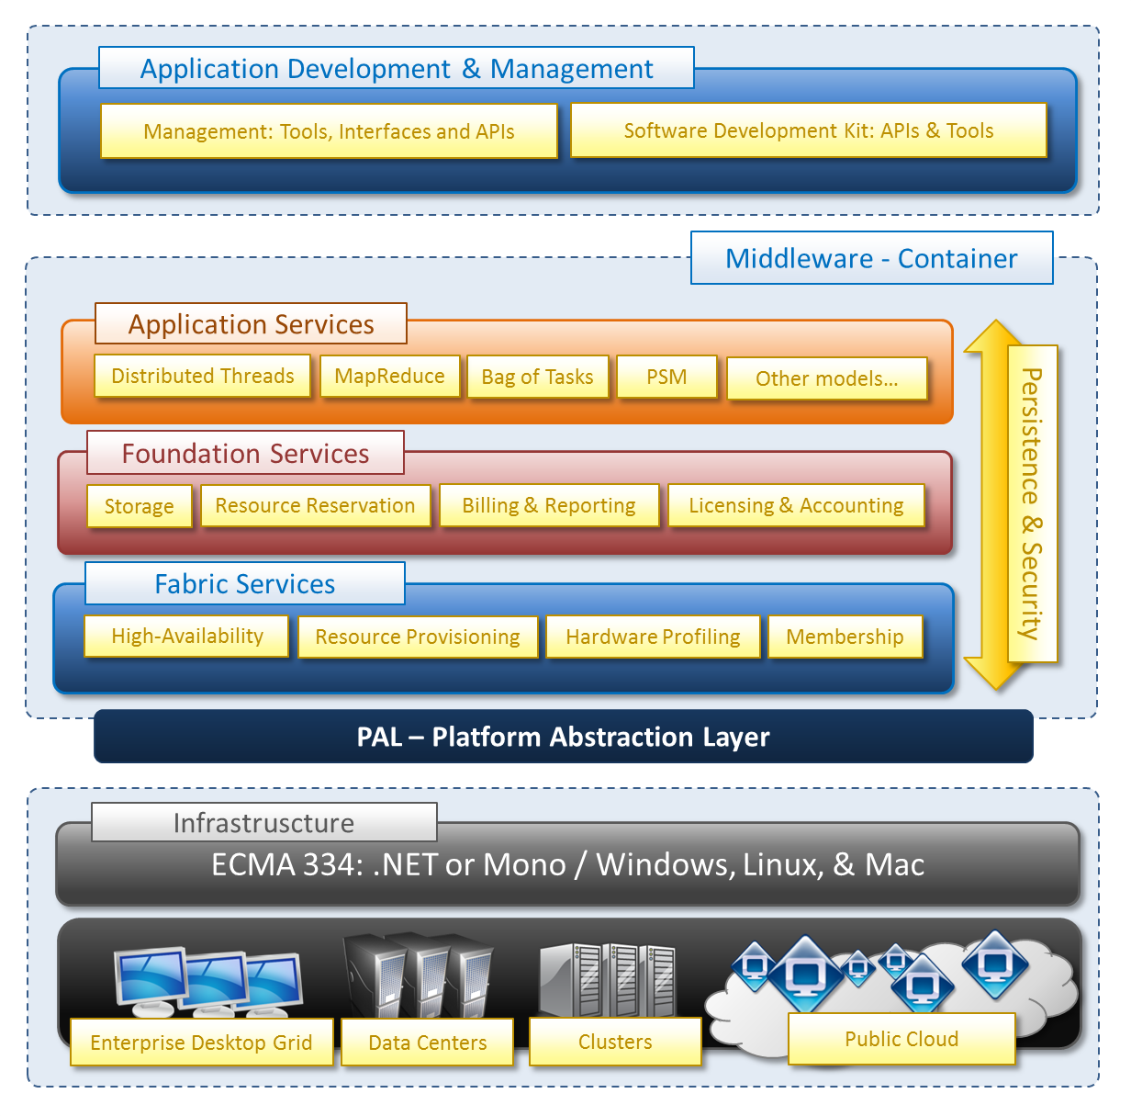
Aneka Architecture

Slide 5
Aneka Features
Build
→allows you to build different run-time environments and build new applications.
Accelerate
→Rapid development and deployment of applications in multiple run-time environments.
Manage
→management includes a Graphical User Interface (GUI) and APIs to set-up, monitor, manage and maintain remote and global Aneka compute clouds.

Slide 6


Build
Aneka includes a Software Development Kit (SDK) which includes a combination of APIs and Tools to enable you to express your application.
It also allows you to build different run-time environments and build new applications.

Slide 7


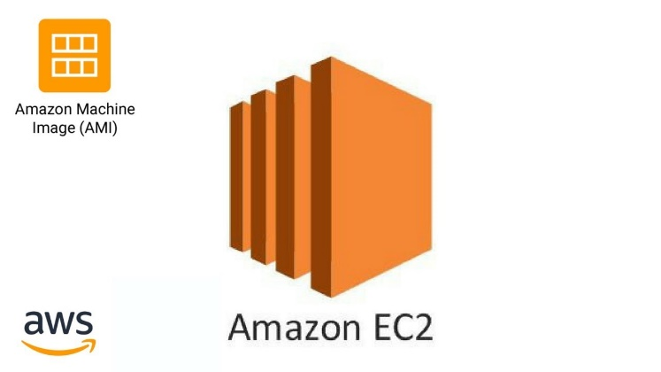
Accelerate
Rapid Scalability of the resources
Uses physical machines as much as possible to achieve maximum utilization in local environment.
As demand increases, Aneka provisions VMs via private clouds (Xen or VMWare) or Public Clouds (Amazon EC2).

Slide 8


Manage
Graphical User Interface (GUI) and APIs to set-up, monitor, manage and maintain remote and global Aneka compute clouds.
Monitor
Accounting mechanism and manages priorities and scalability based on SLA/QoS which enables dynamic provisioning.
Manage

Slide 9
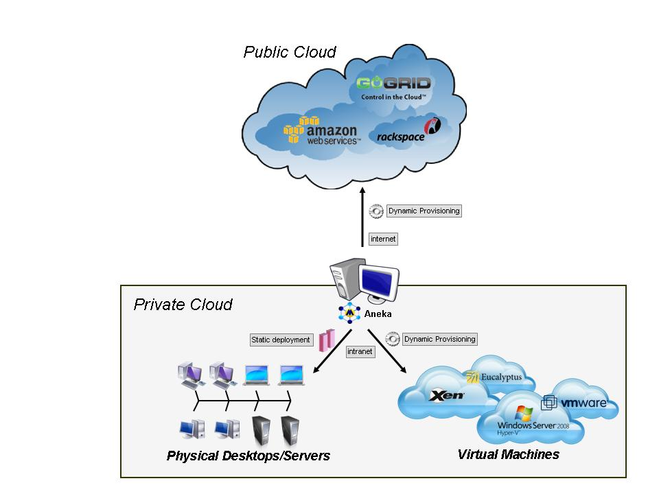
Resource Provisioning over Public and Private Cloud

Slide 10
Lets take a scenario……..
Problem Statement:
Suppose a customer may need 30 resources for completion of an application within an hour.
Constraint→ Customer willing to spend a maximum of 5 dollars.
Given Information→ Customer is currently acquiring 5 resources
Solution
Static provisioning
12 resources from private cloud (XEN Hypervisor)
Dynamic provisioning
13 resources from public cloud (Amazon Public Cloud)

Slide 11
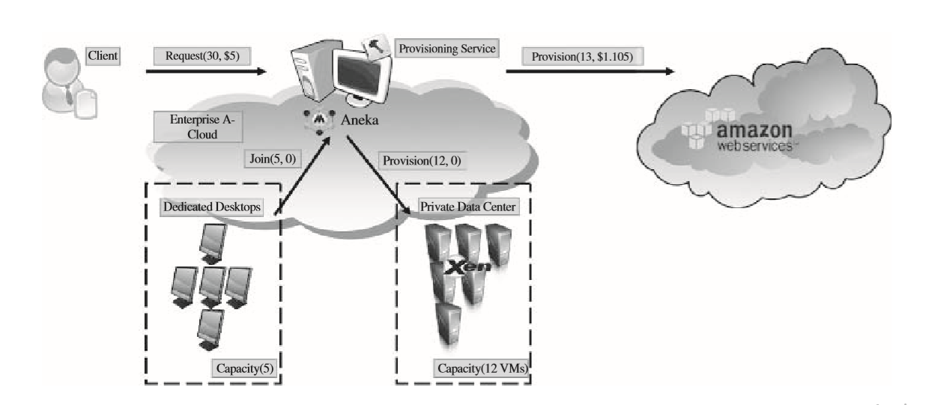
Effective Solution with Aneka
3
1
2
6
4
5

Slide 12
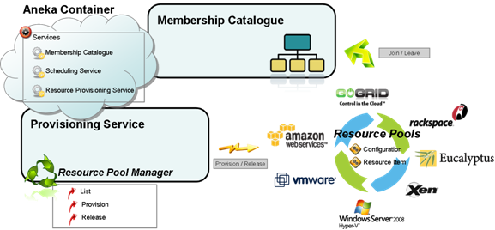
Aneka Resource Provisioning

Slide 13
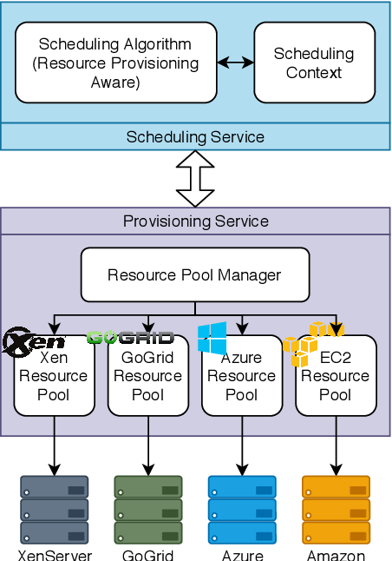
Aneka Hybrid Cloud Architecture
Resource Pool Manager
Resource Pool
Resource Provisioning Service
This manages all the registered resource pools and decides how to allocate resources from those pools.
A resource pool is in charge of managing the virtual resources it contains and eventually releasing them when they are no longer in use.
Implements the service interface and wraps the resource pool manager, thus allowing its integration within the Aneka container.

Slide 14
Amazon Web Services:Aneka Role
User Identity
Resource Identity
Resource Capacity
Amazon Machine Image (AMI) that is used as template from which to create virtual machine instances
This represents the account information used to authenticate withAmazonEC2s
This speciﬁes the different type of instance that will be deployed by Amazon EC2(small, medium, and large)

Slide 15
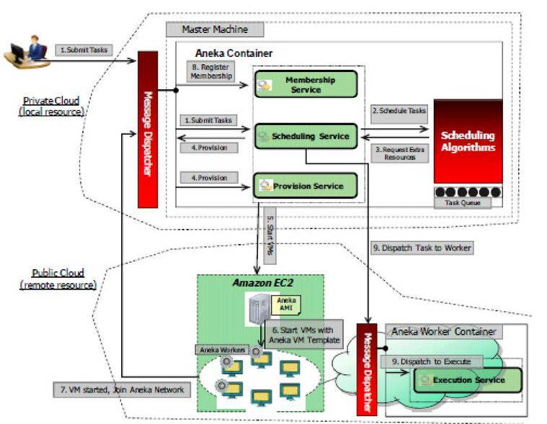
The Amazon EC2 Resource Pool

